Slide 1



I Like Big Trees
Shanden Key - Nashville Software School -DDA11

Slide 2
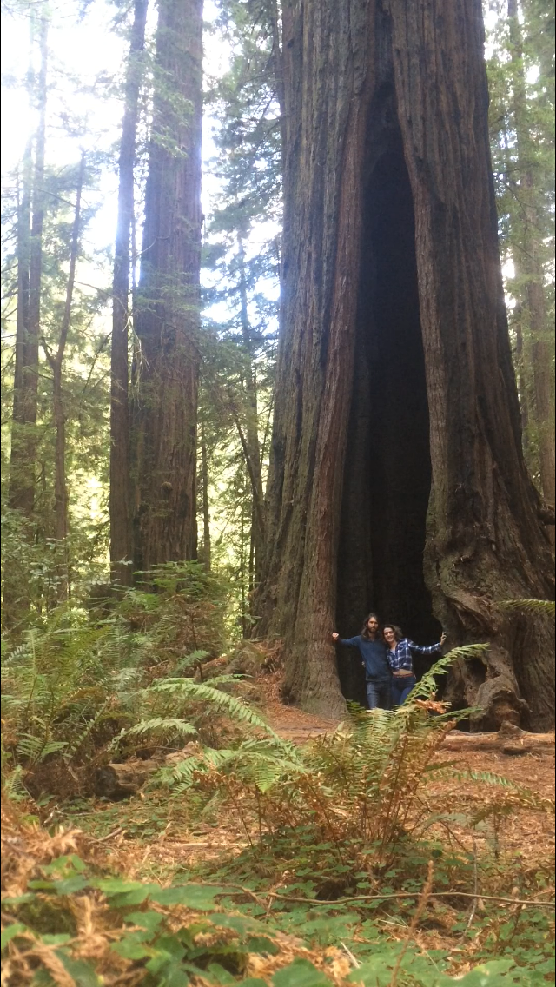
Let’s see California’s Giants
After a two day drive along Highway 101 to see the Costal Redwoods, the immediate knowledge that more trees
and more time in them was needed was immediate.

Slide 3

Topics Covered
The Trees
Agenda:
Visitor Numbers
Monthly Temperatures
Monthly Precipitation
Challenges

Slide 4
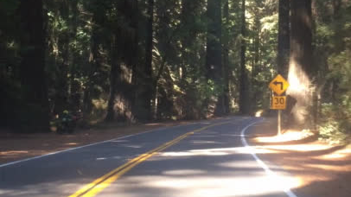
Notes:
clip video start

Slide 5

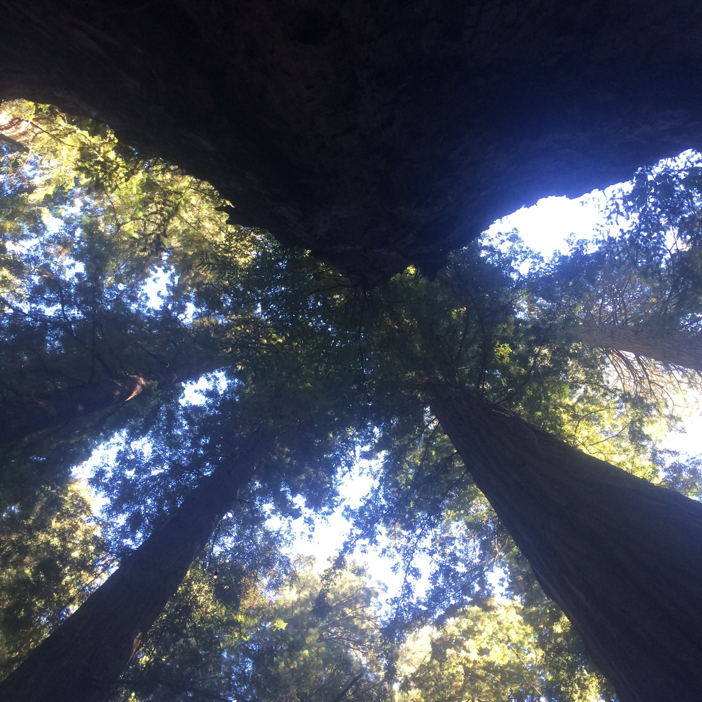
LETS TALK ABOUT THE TREES
Giant Sequoias - Larger by volume & interior of state
Coastal Redwoods - Taller and coastal
Notes:
interior vs coastal

Slide 6
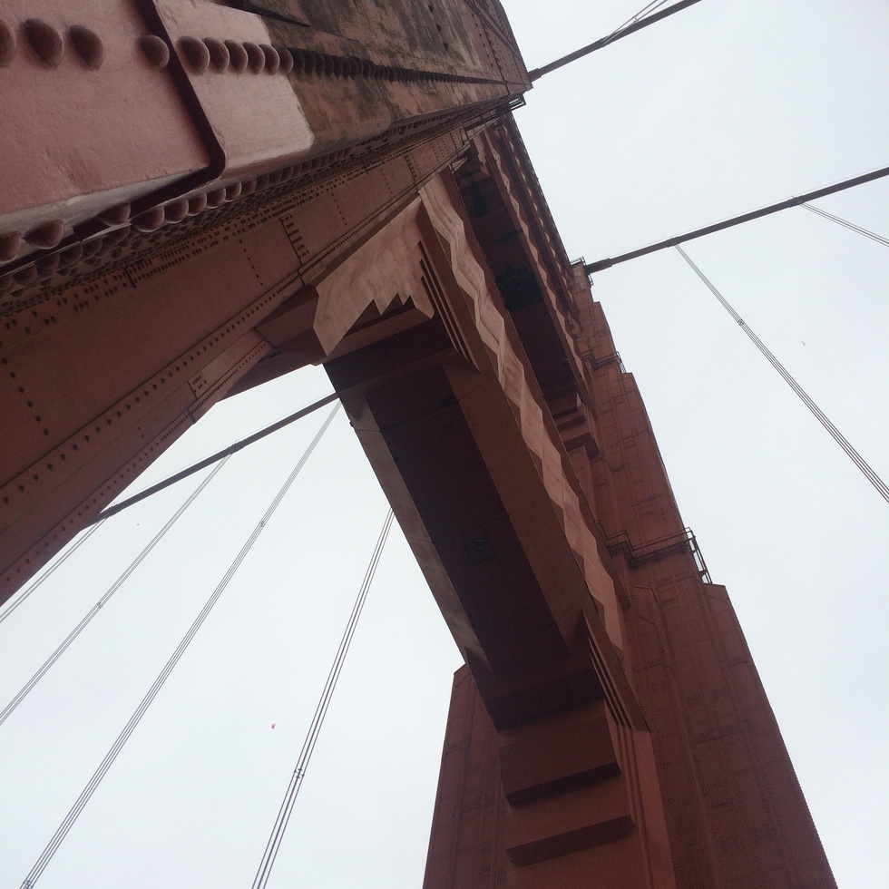
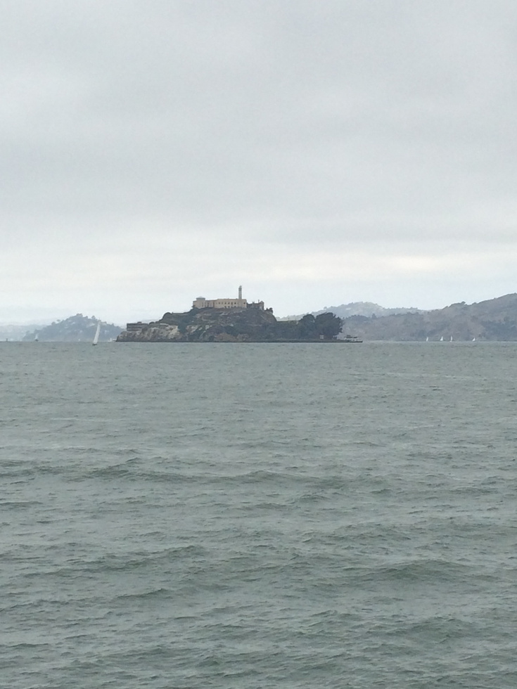
What’s YOUR best time to plan a visit to the trees?
Park Visitor Numbers
Weather Watching
when are parks the busiest, what parks are the busiest
what time of year has the best weather for you

Slide 7
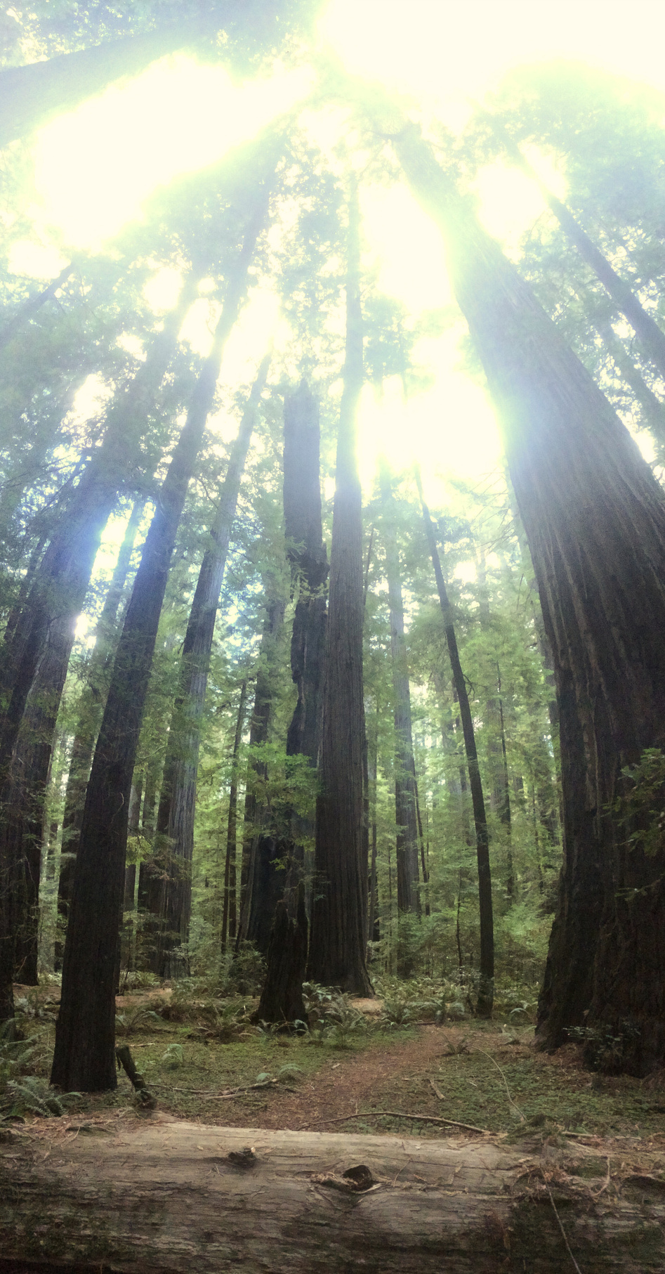

Park Visitor Numbers
Weather Watching
When
and Where do
I am people averse, so September numbers work for my anxiety.
I am okay with any amount of rain, and temperatures between 50-70.
I
go to next...
King’s Canyon & Sequoia
National Parks

Slide 8
Secondary data sourcing and formatting
Challenges:
Reliable secondary information
Webscraping Impossibilties

Slide 9
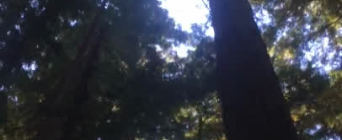
Pick a season to walk among the California giants, and
enjoy the breeze.

